Slide 1

Air Quality Index (AQI) Prediction Using Machine Learning
Intern: Shaik Mohammad Waasif Ansari
Internship: Data Science Intern, Cognifyz Technologies
Tools: Python, Pandas, NumPy, Scikit-learn, Matplotlib

Slide 2
Introduction: Understanding Air Quality Prediction
What is AQI?
Why Predict AQI?
The Air Quality Index (AQI) is a standardized metric that measures air pollution levels based on key pollutants including PM2.5, PM10, NO₂, SO₂, CO, and O₃.
Early warnings enable proactive public health responses
Helps governments & organizations implement targeted pollution management strategies
AQI values range from 0 (Good) to 500 (Hazardous), providing a clear, actionable measure of air quality that impacts public health decisions.
Reveals environmental impacts and pollutant relationships affecting air quality
Project Objective
Leverage Machine Learning algorithms to accurately predict AQI values based on environmental factors, comparing multiple models to identify the optimal approach for real-world air quality forecasting.

Slide 3

Dataset Overview
Dataset Size
Key Pollutants
city_day.csv
PM2.5, PM10, NO2, NOx, CO, SO2, O3, Benzene
29,531 records
16 features
Target Variable
Metadata
AQI - Measures air pollution levels
Date & City identifiers for spatiotemporal analysis
Plus categorical AQI Bucket classification
AQI Classification Ranges
0-50: Good
51-100: Satisfactory
Air quality is satisfactory with minimal health impact
Acceptable air quality for most individuals
101-200: Moderate
201-300: Poor
May affect sensitive groups
Everyone may experience health effects
301-400: Very Poor
401-500+: Severe
Health alert - serious effects for all
Emergency conditions affecting entire population

Slide 4


Data Preprocessing Pipeline
Handling Missing Values
Target Variable Protection: Rows with missing AQI values were completely removed to ensure model accuracy and prevent training on incomplete targets.
Feature Imputation: For numerical features (PM2.5, PM10, NO2, etc.), missing values were filled using mean imputation, replacing nulls with column averages to preserve data distribution.
Feature Scaling
Data standardization applied using StandardScaler, transforming all features to achieve zero mean and unit variance.
Why Scaling Matters: Standardization ensures models like Linear Regression and Neural Networks perform optimally by equalizing feature magnitudes, preventing features with larger scales from dominating predictions.
Data Quality Impact: These preprocessing steps reduced noise, improved model convergence speed, and enhanced overall prediction reliability across all three algorithms tested.

Slide 5
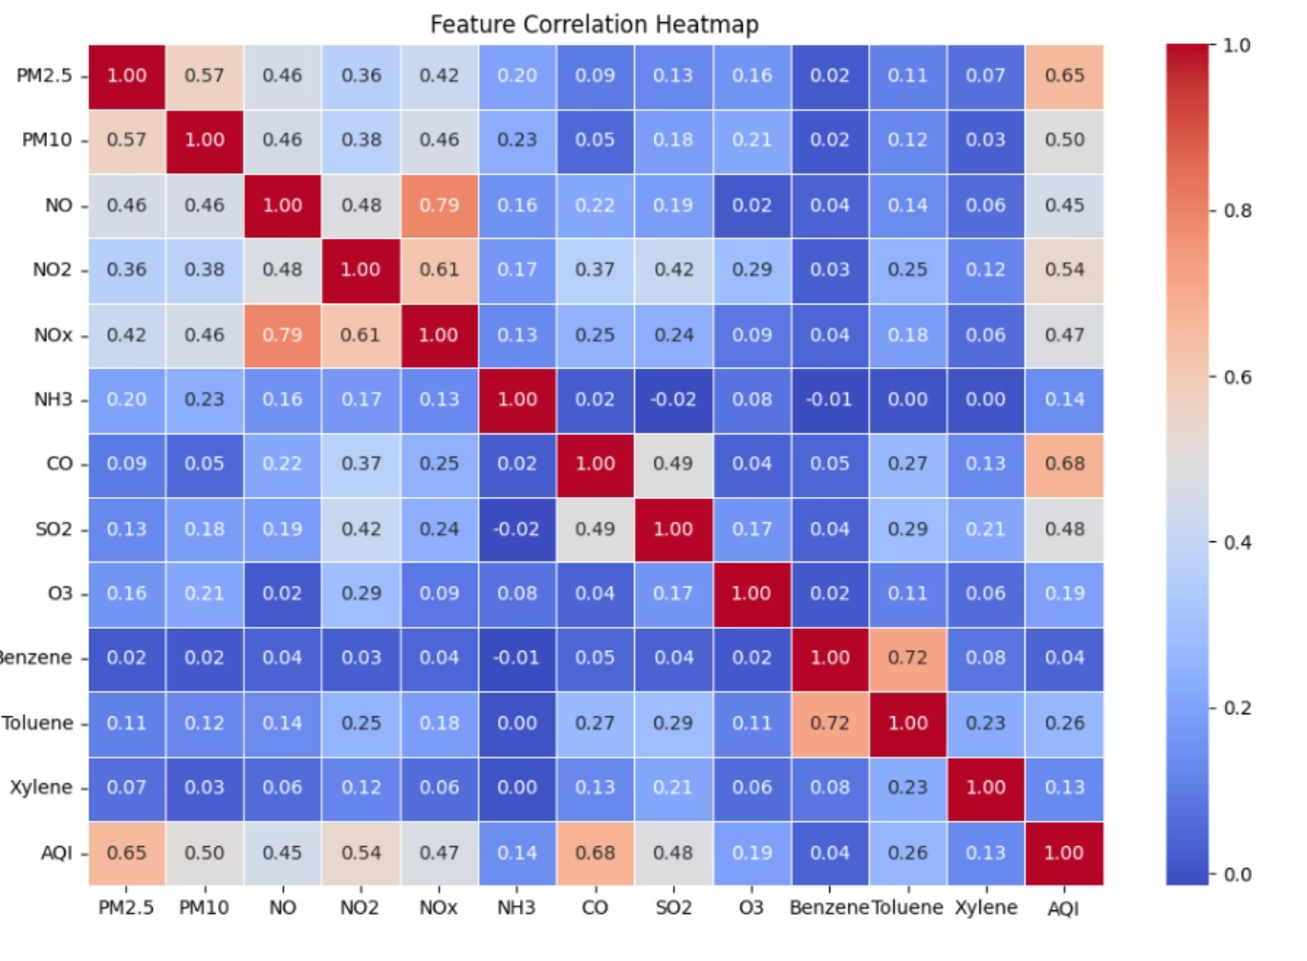

Feature Correlation Analysis
Purpose & Methodology
The correlation heatmap visualizes statistical relationships between AQI and various pollutants, helping identify the most influential features for accurate prediction.
Key Insights
PM2.5 (0.65) and CO (0.68) demonstrate strong positive correlations with AQI, establishing them as critical predictors
PM10, NO2, and SO2 contribute significantly to AQI fluctuations
Weak correlations for O3, Benzene, and Xylene indicate lesser direct impact
Feature Selection Impact: This correlation analysis informed feature engineering decisions and validated the inclusion of particulate matter and carbon monoxide as primary predictive variables.

Slide 6

Machine Learning Models
Linear Regression
Random Forest Regressor
XGBoost Regressor
Approach: Predicts continuous AQI values by identifying direct linear relationships between input pollutant features and target output.
Approach: Ensemble method using multiple decision trees, combining their predictions through averaging for improved accuracy.
Approach: High-performance gradient boosting algorithm that sequentially enhances weak models, correcting errors iteratively.
Strengths: Handles non-linearity excellently, reduces overfitting, resilient to missing data
Strengths: Simple, interpretable, fast training
Strengths: Fast, scalable, highly accurate with built-in regularization
Limitations: Struggles with complex, non-linear patterns common in environmental data
Advantages: Captures complex pollutant interactions effectively
Advantages: Prevents overfitting while maintaining superior predictive power

Slide 7




Training & Evaluation Framework
Train-Test Split
Evaluation Metrics
Performance Analysis
Dataset divided into 80% training and 20% testing subsets
Three complementary metrics assess model performance comprehensively
Compare models across metrics to identify optimal approach
Ensures models learn patterns while maintaining validation integrity
Model Evaluation Metrics Explained
Mean Absolute Error (MAE)
Measures the average absolute difference between actual and predicted AQI values. Lower MAE indicates superior model accuracy with predictions closer to ground truth.
Interpretation: Easy to understand - represents average prediction error in AQI units.

Slide 8

Model Performance Results
Root Mean Squared Error (RMSE)
Similar to MAE but penalizes larger errors more strongly through squaring, making it sensitive to outliers and helping identify models that make significant prediction deviations.
R² Score (Coefficient of Determination)
Quantifies how well the model explains variance in AQI predictions. Values range from 0 to 1, where 1 indicates perfect fit and 0 means no predictive capability.
Comparative Performance Analysis
Model
MAE
RMSE
R² Score
Linear Regression
31.20
59.11
0.809
Random Forest
20.59
40.48
0.911
XGBoost
21.84
42.38
0.902
Winner: Random Forest achieved the lowest error rates and highest R² score, demonstrating superior predictive accuracy across all metrics.

Slide 9
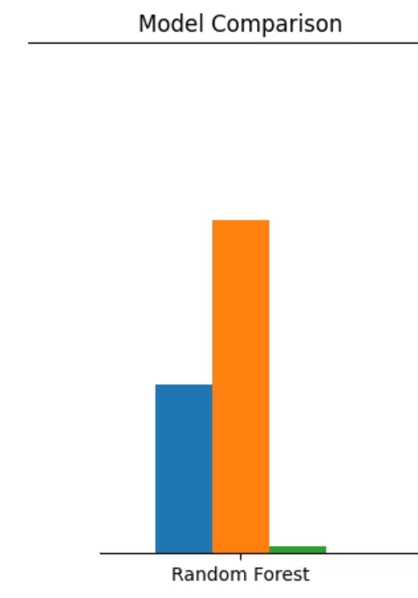
Model Comparison Visualization
The visualization above clearly demonstrates performance differences across our three models. Random Forest consistently outperforms Linear Regression and closely matches XGBoost, with noticeably lower error rates and superior R² scores.
34%
31%
91%
MAE Improvement
RMSE Reduction
R² Score
Variance explained by Random Forest
Random Forest vs Linear Regression
Random Forest vs Linear Regression

Slide 10
Why XGBoost Is Preferred Over Random Forest
While Random Forest achieved slightly better metrics in our specific evaluation, XGBoost offers critical advantages for production deployment and scalability:
1
2
3
Better Handling of Missing Data
Less Overfitting Risk
Captures Complex Relationships
XGBoost processes missing values natively during tree construction, while Random Forest requires separate imputation preprocessing steps.
Random Forest may overfit when dealing with correlated pollutants, while XGBoost's regularization techniques generalize better to unseen data.
The gradient boosting technique models intricate AQI-pollutant interactions more effectively through sequential error correction.
4
5
Higher Predictive Accuracy Potential
Efficiency & Speed at Scale
XGBoost iteratively corrects prediction errors, continuously improving performance beyond individual decision trees.
Optimized for faster training and superior scalability on large datasets (our 29,000+ rows and beyond), with parallel processing capabilities.
Recommendation: For production deployment, XGBoost is preferred due to its robustness, scalability, and built-in handling of real-world data challenges, despite Random Forest's marginal performance edge in this specific evaluation.

